Slide 1
Business and Industrial Economics
Prof. Luca Grilli
Externalities, Asymmetric Information, Transaction costs: questions and exercises

Slide 2
Exam 21st June 2019

Slide 3
Externality (Cabral, 2018, chapter 5, p. 118)
1) Different divisions within a firm frequently compete for a common resource. Suppose that divisions 1 and 2 of a given firm share a common facility F. Let q_{i} be the service level used by division i (i = 1, 2). The division i’s benefit in terms of divisional earnings (i.e. divisional profits) is given by the following expression: q_{i} – 0.25 (q_{i})^2 – 0.1(q₁₊ q₂). Please gauge the following statements:
the equilibrium levels of q_{i} if the various divisions act separately is q₁ = q₂ = 1.8, while the optimal level from an overall firm point of view is q₁ = q₂ = 1.6, given the presence of negative externalities between the two divisions.
the equilibrium levels of q_{i} if the various divisions act separately is q₁ = q₂ = 1.8, while the optimal level from an overall firm point of view is q₁ = q₂ = 1.4, given the presence of positive externalities between the two divisions.
the equilibrium levels of q_{i} if the various divisions act separately is q₁ = q₂ = 1.6, while the optimal level from an overall firm point of view is q₁ = q₂ = 1.8, given the presence of negative externalities between the two divisions.
the equilibrium levels of q_{i} if the various divisions act separately is the same as the optimal one from an overall firm point of view with q₁ = q₂ = 1.5, since there are no externalities between the two divisions.

Slide 4
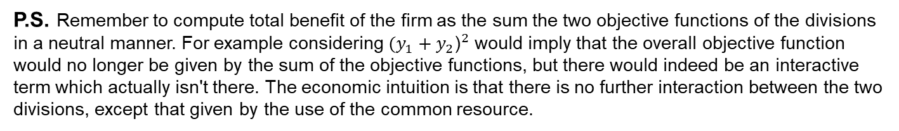
Solution (from Cabral, 2018)
P.S. Remember to compute total benefit of the firm as the sum the two objective functions of the divisions in a neutral manner. For example considering ${(y_{1}+y_{2}\text{)}}^{2}$ would imply that the overall objective function would no longer be given by the sum of the objective functions, but there would indeed be an interactive term which actually isn't there. The economic intuition is that there is no further interaction between the two divisions, except that given by the use of the common resource.

Slide 5
Adverse selection in Insurance Mkt (Cabral 2018, II edition, Chapter 7.4, pp. 174-176)
Consider the following sequential game between an insurance company and a patient. First, the insurance company decides whether to charge a high premium or a low premium, then the patient decides whether or not to accept the company’s offer. The patient may either be a low-risk patient or a high-risk patient; moreover, the patient knows what type is but the insurance company does not. Specifically, the insurance company believes that with probability 10% the patient is a high-risk patient. For a high risk patient, health insurance is worth 20,000€ a year, whereas for a low-risk patient the value is 3,000€. For the insurance company, the cost of providing insurance is 30,000€ for a high-risk patient, and 1,000€ for a low-risk patient.
Based on the prior probabilities that the patient is high or low risk, the insurer estimates that:
The average evaluation for the consumer is: 10%*20K + 90%*3K = 4.7K
The average cost of insuring a patient is: 10%*30K + 90%*1K = 3.9K
Based on these average, the company is considering two possible prices (premiums):
p = 4,500 € (that is below the average valuation but above the average cost).
p = 30,000 € (a price that covers cost regardless of patient type).
Insurer plays first, then “Nature” makes its move, finally patient decides whether to accept or not
Which equilibrium will emerge?

Slide 6
Extensive game with asymmetric info
-25.5, 15.5
Accept
(10%) High risk
P_{H}
Don’t’
0, 0
N
3.5, -1.5
(90%) Low risk
P_{L}
Accept
p = 4.5K
Don’t’
0, 0
I
0, -10
Accept
p = 30K
(10%) High risk
P_{H}
Don’t’
0, 0
N
Accept
29, -27
(90%) Low risk
P_{L}
Don’t’
0, 0

Slide 7
Extensive game with asymmetric info
-25.5
-25.5, 15.5
Accept
-25.5*10% + 0*90% = -2.5
(10%) High risk
P_{H}
Don’t’
0, 0
N
3.5, -1.5
(90%) Low risk
P_{L}
Accept
p = 4.5K
Don’t’
0, 0
0
I
0
0, -10
Accept
p = 30K
(10%) High risk
P_{H}
Don’t’
0, 0
N
(90%) Low risk
Accept
29, -27
P_{L}
0*10% + 0*90% = 0
Don’t’
0, 0
0
(Bayesian)-Nash equilibrium

Slide 8
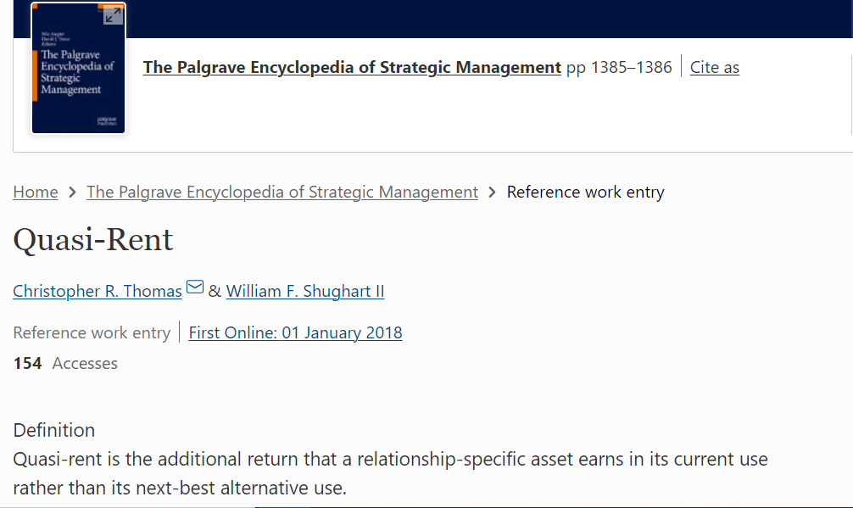
Transaction costs (quasi-rent) (Besanko et al. 2000, chapter 3 )
Suppose you manufacture 5 million hard drives per year specifically for Dell laptop computers. Suppose your average variable cost C=$10/unit, annualized cost of investment to build a hard drive factory I=$40 million (I is an unavoidable cost, you have to make your payment even if you do not do business with Dell), and the market price (bailout market price in the event Dell does not buy) P_{m}=$15/unit. If Dell agrees to purchase the 5 million hard drives at a price P*=$25/unit and the deal subsequently falls apart, what is your company’s “quasi-rent”?
$10 million.
$50 million.
$30 million.
-$10 million.
Q(P* - Pm)

Slide 9
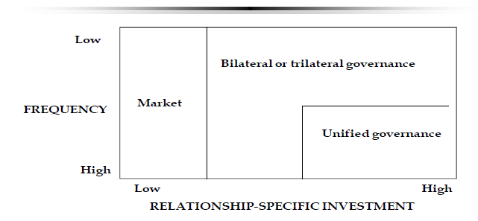
Taxonomy of Transactions (Williamson, 1986)
According to the classification of transactions (Williamson, 1986), transactions will be governed by the market only when:
Both relationship-specific investments and frequency of transactions are low.
Relationship-specific investments are high and frequency of transactions is low.
Relationship-specific investments are low, unregardless of the frequency of transactions which can be low or high.
Relationship-specific investments are low and frequency of transactions is high.

Slide 10
General Question on the 3 pillars of TCE (BIE Call February 2023)
Using only the concepts and arguments seen in the BIE course (others would be evaluated negatively), explain what the three pillars of transaction cost economics are and explain why we need all of them to explain that the market does not work efficiently.
Example of a very good answer
The first pillar is bounded rationality, which leads to contractual incompleteness. Economic agents suffer from substantial and procedural limits on their ability to be fully rational, and the contracts they are able to stipulate will inevitably neglect to include something potentially relevant. The second pillar is opportunism, where individuals may behave inappropriately from the perspective of the other side, but these opportunistic agents are not identifiable ex ante. The third pillar is the presence of relationship-specific investments, i.e. investments that are not (fully) redeployable outside the focal transaction. The simultaneous presence of all three elements makes the use of the market to regulate economic transactions costly and make the use of alternative modes to regulate the transaction preferable (e.g. hierarchy). But all three pillars have to be in place. In fact, if contracts are complete, even if agents are opportunistic and there are relationship-specific investments, there is no incompleteness to exploit: all contractual details are perfectly spelled out, and breaches are easily detectable and punishable by any legal force in charge. If there are no opportunistic agents, even in the presence of contractual incompleteness and relationship-specific investments, no agent will want to hold up the counterparty. If there are no relationship-specific investments, even in the presence of contractual incompleteness and opportunism, each party can easily switch to an alternative counterpart on the same terms (i.e. the quasi-rent is equal to zero).

Slide 11
Business and Industrial Economics
Prof. Luca Grilli
Innovation and technological change: Introduction

Slide 12
INNOVATION
“INNOVATION has become the industrial religion of the late 20th century. Business sees it as the key to increasing profits and market share. Governments automatically reach for it when trying to fix the economy.”
“The Economist”, February 20th 1999, Survey of Innovation in Industry

Slide 13
The European Example
The Lisbona Strategy (2000)
“To become the most dynamic and competitive knowledge-based economy in the world”
Europe 2020 (2010)
“A European strategy for smart, sustainable and inclusive growth”
Research and innovation are placed at the centre of the Europe 2020 strategy (Horizon 2020). This includes the headline objective of increasing spending on R&D to 3% of GDP by 2020.
R&D
Growth & Development (Sustainability, Inclusion, etc.)
See also the EU Strategic Plan 2020-2024
(“The 2030 Agenda for Sustainable Development” with the 17 SDGs)
For last data from Eurostat see
R&D expenditure - Statistics Explained (europa.eu)

Slide 14

Competitive markets are the ultimate goal
Perfect competition equilibrium
p = MC = AC min
The maximum quantity of the good produced at the lowest possible cost= Max Productive efficiency (goods and services are produced using the least costly combination of resources and technology)
The maximum quantity of the good sold at the lowest price= Max Allocative efficiency (resources are dedicated to the combination of goods and services that best satisfy consumer needs)

Slide 15
But things are more complicated
Dynamic efficiency
Improvement and generation over time of new products and production techniques
TODAY
TOMORROW

Slide 16
Economic background (milestones)
Solow (1956, 1957): the “Solow residual”
Griliches (1990, JEL) and the “CDM” Model (Crepon, Duguet & Mairesse, 1998, EINT)
ΔY/Y = θ(ΔK/K)+ (1-θ)(ΔL/L)+ ΔA/A
Rate of economic growth
Rate of growth of Capital
Rate of growth of Labor
Technical change
Solow (1957, RES) shows that for US between 1909-1947 technical change accounted for 87.5% of economic growth.
Productivity / Growth rates
R&D
Innovation

Slide 17

Economic background (milestones)
The legacy of Schumpeter

Slide 18
Invention vs. Innovation vs. diffusion (see also Usher)
invention (telephone):
(technological) materialization of an intuition which can be engendered by scientific knowledge. Might be exogenous and largely random in nature and can not be influenced by market signals. Can be a process of inspiration, perspiration, both of them, and also a result of “stumbling” over.
innovation (telecommunication service):
transformation of an invention into a new product/service/process.
It addresses new needs (often latent needs) on the part of consumers or firms; influenced by economic signals (like pursuit of profit).
diffusion (telecom penetration)
spread process of an innovation into the economy

Slide 19

Invention vs. Innovation vs. diffusion
Sometimes it’s not always easy to understand what an invention is useful for what (i.e. how to transform it into an innovation).

Slide 20
References
Cabral, Introduction to Industrial Organization (2000), I edition, chapter 16 and/or Introduction to Industrial Organization (2018), II edition, chapter 15
Further reading:
Joseph, A. Schumpeter (1912-1934) . The Theory of Economic Development. An Inquiry into Profits, Capital, Credit, Interest, and the Business Cycle.
Joseph, A. Schumpeter (1942) . Capitalism, Socialism and Democracy.
Comino, Manenti, Industrial Organization of High-technology markets, chapter 6.
Pepall, Richards, Norman, Industrial Organization: contemporary theory and empirical applications, chapter 18.

